Slide 1

Oracle 11g features
- OSN Team
- OSN Team
Notes:
Welcome to the Continuous Integration e-learning course.

Slide 2


Agenda
Respect or Ignore Null
Nth Values
Truncate DROP ALL Storage
APPEND_VALUES Hint
Listagg
Recursive sub query factoring
Ignore_row_on_dupkey_index
Preprocessor
Unstructured Data Management
  Introduction to Data Structure
  LOBS
  Secure Files
  Secure Files Innovation
  Migration of existing LOB’s
  LOB history & Storage details
  LOB’s in GBS
Notes:
Welcome to the Continuous Integration e-learning course.

Slide 3

Respect or Ignore Null
Notes:
Welcome to the Continuous Integration e-learning course.

Slide 4

Respect or Ignore Null
Used with SQL analytical functions.
Is null values of expression are included in or eliminated from the calculation
The default is RESPECT NULLS.
Example
If the last value in the set is null, then the function returns NULL unless you specify IGNORE NULLS
Notes:
Welcome to the Continuous Integration e-learning course.

Slide 5
Anything Similar
NULLS FIRST
NULLS LAST
Notes:
Welcome to the Continuous Integration e-learning course.

Slide 6
Respect or Ignore Null
Respect Null | Use null value in the computation. Default value
Ignore Null | Ignore null value in the computation. For any analytical function if the value in set is null, then the function returns NULL unless we specify IGNORE NULLS.. Specifying IGNORE NULLS, then First (analytical function) returns the first non-null value in the set, or NULL if all values are null.
Notes:
Welcome to the Continuous Integration e-learning course.

Slide 7
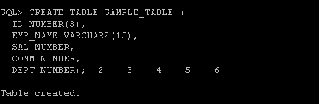
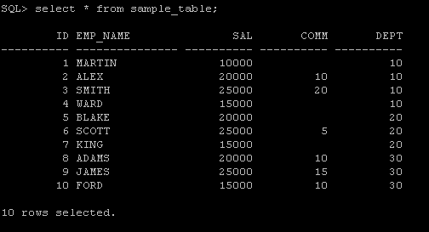
Respect or Ignore Null - Demo
Notes:
Welcome to the Continuous Integration e-learning course.

Slide 8
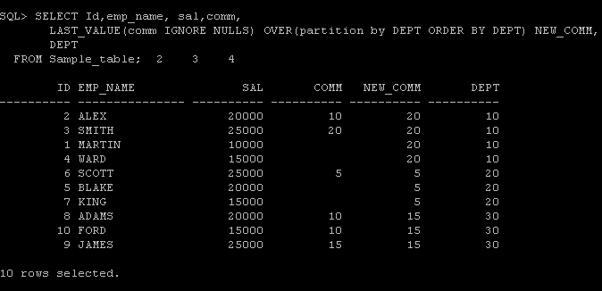
Respect or Ignore Null - Demo
Notes:
Welcome to the Continuous Integration e-learning course.

Slide 9

Nth Values
Notes:
Welcome to the Continuous Integration e-learning course.

Slide 10
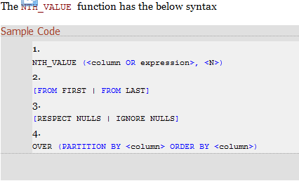
Nth Values
New analytical function to find out the nth value in a set
To find out the nth largest value from a set of values or by grouping some set of values.
Notes:
Welcome to the Continuous Integration e-learning course.

Slide 11
Options in Nth Values
{RESPECT | IGNORE} NULLS
To determine whether null values of measure_expr are included in or eliminated from the calculation. The default is RESPECT NULLS.
FROM {FIRST | LAST}
To determine whether the calculation begins at the first or last row of the window. The default is FROM FIRST.
N
To determine the nth row for which the measure value is to be returned. n can be a constant, bind variable, column, or an expression.
Notes:
Welcome to the Continuous Integration e-learning course.

Slide 12
Nth Values ( Contd..)
Analytical Function NTH_VALUE returns the NTH_VALUE in a WINDOW
FIRST_VALUE(column) == NTH_VALUE(column,1)
LAST_VALUE(column) == NTH_VALUE(column,1) FROM LAST
FROM FIRST (default) and FROM LAST can be used to start counting at either end of the window
NTH_VALUE( sal ,2) over (order by sal desc)
==
NTH_VALUE( sal ,2) FROM FIRST over (order by sal desc)
Notes:
Welcome to the Continuous Integration e-learning course.

Slide 13
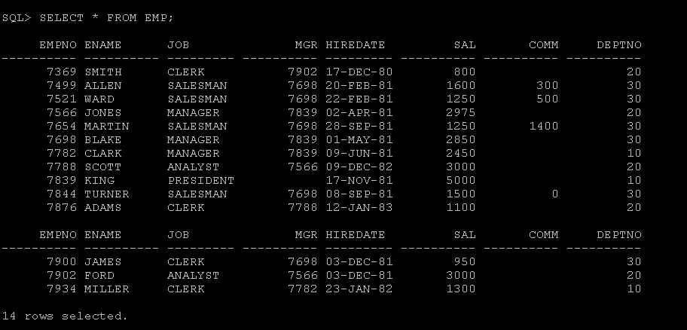
Nth Values - Demo
Notes:
Welcome to the Continuous Integration e-learning course.

Slide 14
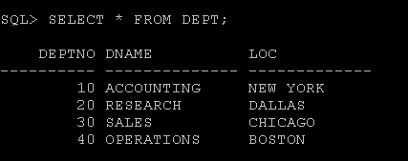
Nth Values - Demo
Notes:
Welcome to the Continuous Integration e-learning course.

Slide 15
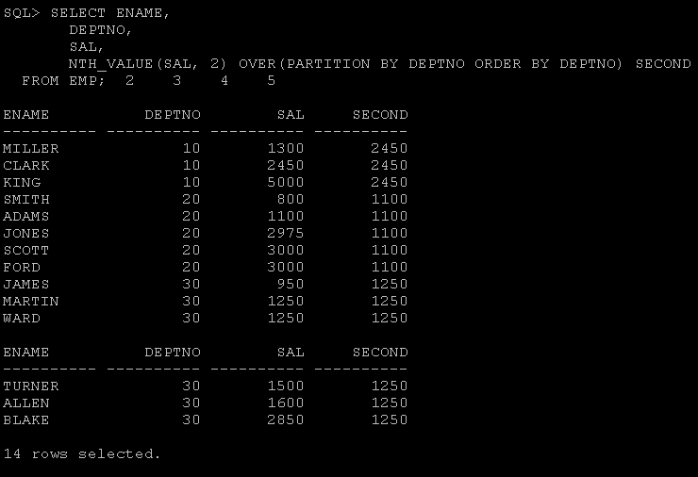
Nth Values - Demo
Notes:
Welcome to the Continuous Integration e-learning course.

Slide 16
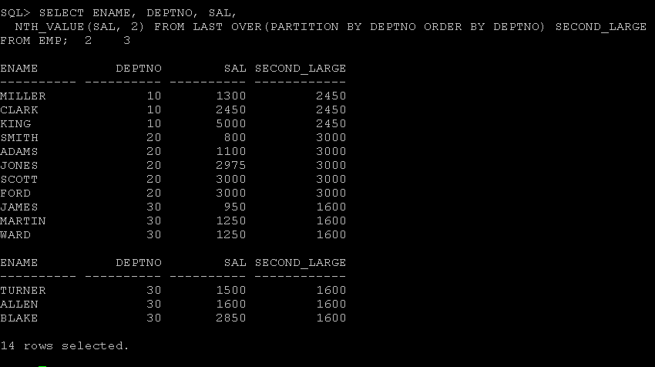
Nth Values - Demo
Notes:
Welcome to the Continuous Integration e-learning course.

Slide 17
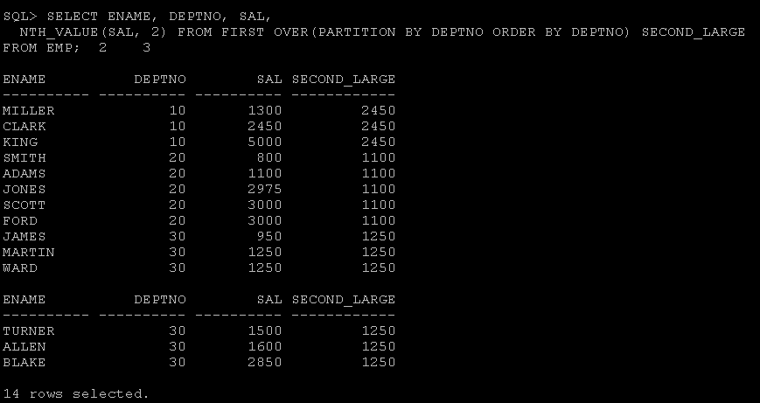
Nth Values - Demo
Notes:
Welcome to the Continuous Integration e-learning course.

Slide 18

Truncation
Notes:
Welcome to the Continuous Integration e-learning course.

Slide 19
Truncation
TRUNCATE TABLE has a new clause DROP ALL STORAGE that lets you deallocate all segments for a table.
The STORAGE clauses let you determine what happens to the space freed by the truncated rows.
  The DROP STORAGE clause (Default)
  DROP ALL STORAGE clause
  REUSE STORAGE clause
Notes:
Welcome to the Continuous Integration e-learning course.

Slide 20
Storage Clauses
DROP STORAGE
  To deallocate all space from the deleted rows from the table except the space allocated by the MINEXTENTS parameter of the table.
  This space can subsequently be used by other objects in the table space.
DROP ALL STORAGE
  To deallocate all space from the deleted rows from the table, including the space allocated by the MINEXTENTS parameter.
Notes:
Welcome to the Continuous Integration e-learning course.

Slide 21
Reuse Storage
To retain the space from the deleted rows allocated to the table.
Storage values are not reset to the values when the table was created.
The space can subsequently be used only by new data in the table resulting from insert or update operations.
Notes:
Welcome to the Continuous Integration e-learning course.

Slide 22
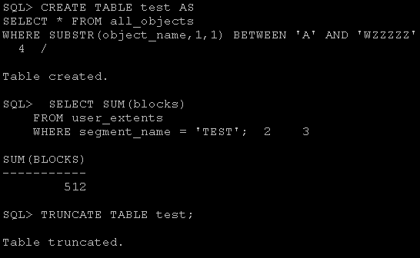
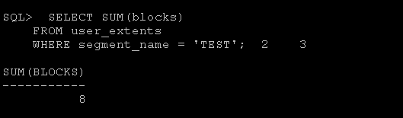
Truncation - Demo
Notes:
Welcome to the Continuous Integration e-learning course.

Slide 23
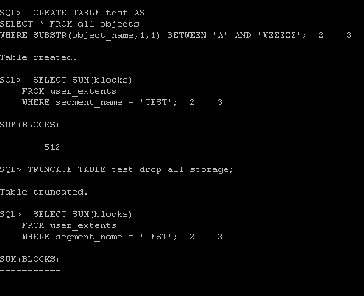
Truncation - Demo
Notes:
Welcome to the Continuous Integration e-learning course.

Slide 24
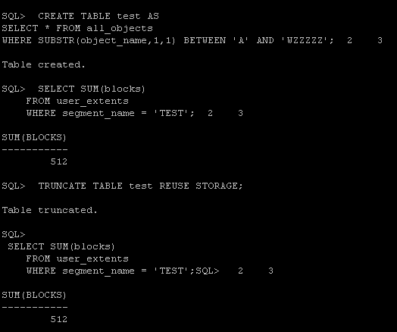
Truncation - Demo
Notes:
Welcome to the Continuous Integration e-learning course.

Slide 25
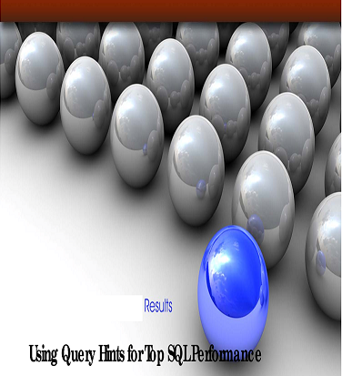
Append Values - Hint
Notes:
Welcome to the Continuous Integration e-learning course.

Slide 26
Append Values - Hint
Take advantage of the performance benefits of direct-path inserts in "INSERT ... SELECT" operations for a long time using the APPEND hint.
INSERT /*+ APPEND */ INTO dest_tab SELECT * FROM source_tab;
Notes:
Welcome to the Continuous Integration e-learning course.

Slide 27
Append Values - Hint
Typically we would only want to do this when the insert statement is part of bulk operation using the FORALL statement
APPEND_VALUES hint gives us better performance by allowing us to use direct-path inserts within the FORALL statement
Notes:
Welcome to the Continuous Integration e-learning course.

Slide 28
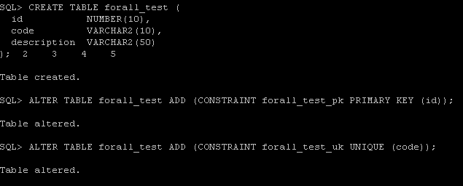
Append Values - Demo
Notes:
Welcome to the Continuous Integration e-learning course.

Slide 29
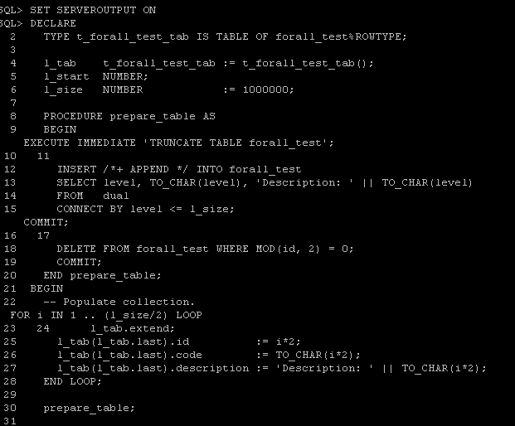
Append Values - Demo
Notes:
Welcome to the Continuous Integration e-learning course.

Slide 30
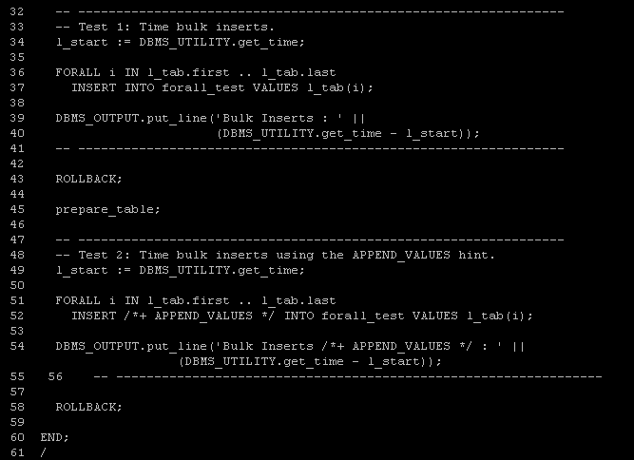
Append Values - Demo
Notes:
Welcome to the Continuous Integration e-learning course.

Slide 31

Append Values - Demo
Notes:
Welcome to the Continuous Integration e-learning course.

Slide 32


Popeye the Sailor Man
- OSN Team
“Popeye the Sailor Man” is liked by
Arockia, Bala, Guna, Venky, Vignesh, Vijay
Notes:
Welcome to the Continuous Integration e-learning course.

Slide 33
Options in Oracle
SYS_CONNECT_BY_PATH
STRAGG
COLLECT
MODEL
WMSYS_CONCAT
REF_CURSOR
Notes:
Welcome to the Continuous Integration e-learning course.

Slide 34
LISTAGG
To group and concatenation of multiple rows into a single row per group
  Syntax
  LISTAGG( [,] ) WITHIN GROUP (ORDER BY ) [ OVER (PARTITION BY )]
  Example
  Select listagg( name, ‘,’ ) within group( order by name ) from like_users
[ ] – Optional syntaxes Deterministic expression as delimiter Order by NULL Varchar2 or CLOB
Notes:
Welcome to the Continuous Integration e-learning course.

Slide 35
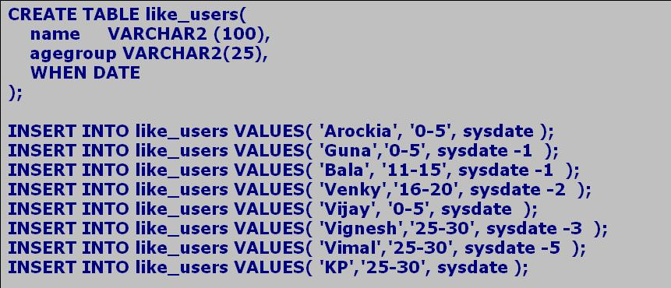
LISTAGG - Demo
Notes:
Welcome to the Continuous Integration e-learning course.

Slide 36
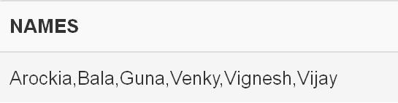
LISTAGG - Demo
Single Set Aggregate
  Operates on all rows and returns a single output row
  SELECT
  listagg(name, ',') within GROUP (ORDER BY name) names
  FROM like_users
http://sqlfiddle.com/#!4/c2878/1
Notes:
Welcome to the Continuous Integration e-learning course.

Slide 37
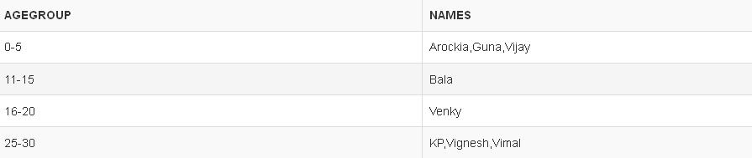
LISTAGG - Demo
Group Set Aggregate
  Returns an output row for each group defined by the GROUP BY
  SELECT agegroup ,
  listagg( name, ',' ) within GROUP(ORDER BY name) names
  FROM like_users
  GROUP BY agegroup
http://sqlfiddle.com/#!4/c2878/2
Notes:
Welcome to the Continuous Integration e-learning course.

Slide 38
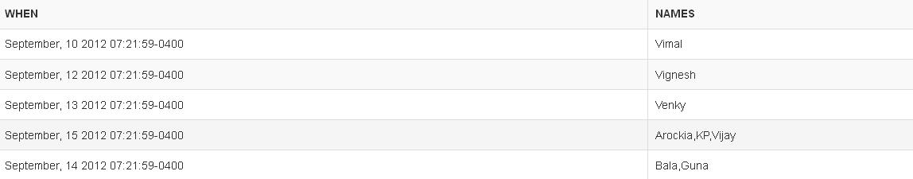
LISTAGG - Demo
Analytic Function
  Partitions the query result set into groups based on PARTITION BY
  SELECT distinct(WHEN),
  listagg( name, ',') within GROUP (ORDER BY name)
  over( partition BY WHEN ) AS names
  FROM like_users;
http://sqlfiddle.com/#!4/c2878/3
Notes:
Welcome to the Continuous Integration e-learning course.

Slide 39
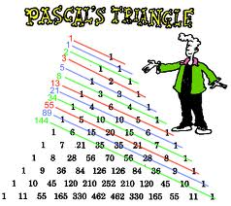
Pascal’s Triangle
Notes:
Welcome to the Continuous Integration e-learning course.

Slide 40
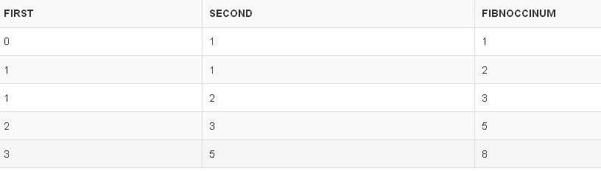
Recursive sub query factoring
WITH fibnocci ( FIRST, SECOND, RESULT, COUNT ) AS
(
SELECT 0 FIRST, 1 SECOND, 1 RESULT, 1 COUNT
FROM dual
UNION ALL
SELECT SECOND, RESULT, SECOND + RESULT, COUNT+1
FROM fibnocci WHERE COUNT < 10
)
SELECT FIRST, SECOND, RESULT fibnoccinum FROM fibnocci
http://sqlfiddle.com/#!4/81e62/1
Notes:
Welcome to the Continuous Integration e-learning course.

Slide 41
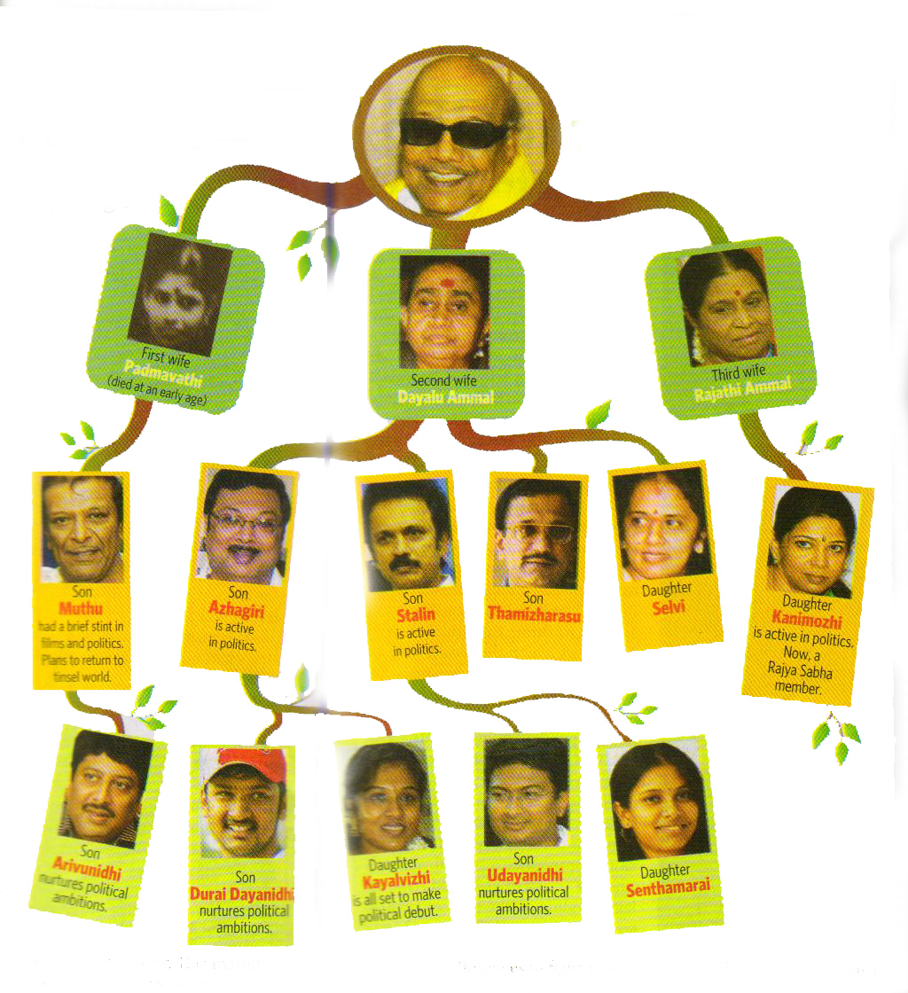
Hierarchical Structure
Notes:
Welcome to the Continuous Integration e-learning course.

Slide 42
Connect By Vs Recursive With
SELECT * FROM family
START WITH parent = 1
CONNECT BY PRIOR parent = child
VS
WITH tree( parent, name, relation, child, age ) AS
(
SELECT parent, name, relation, child, age FROM family WHERE parent = 1
UNION ALL
SELECT f.parent, f.name, f.relation, f.child, f.age FROM tree t, family f WHERE t.parent = f.child
)
SEARCH DEPTH FIRST BY age DESC SET a
SELECT parent, name, relation, child, age FROM tree
ORDER BY a
http://sqlfiddle.com/#!4/710f5/2 http://sqlfiddle.com/#!4/710f5/3
Notes:
Welcome to the Continuous Integration e-learning course.

Slide 43

ORA - 0001
Select Before Insert, Raise exception and catch
Notes:
Welcome to the Continuous Integration e-learning course.

Slide 44
IGNORE_ROW_ON_DUPKEY_INDEX
IGNORE_ROW_ON_DUPKEY_INDEX causes the statement to ignore a unique key violation for a specified set of columns or for a specified index.
Column should have unique index
Special Hint, have a semantic effect
Notes:
Welcome to the Continuous Integration e-learning course.

Slide 45
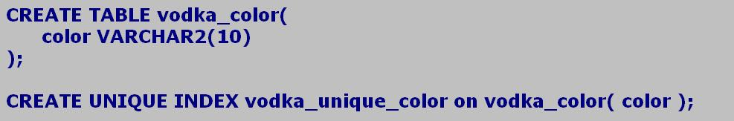
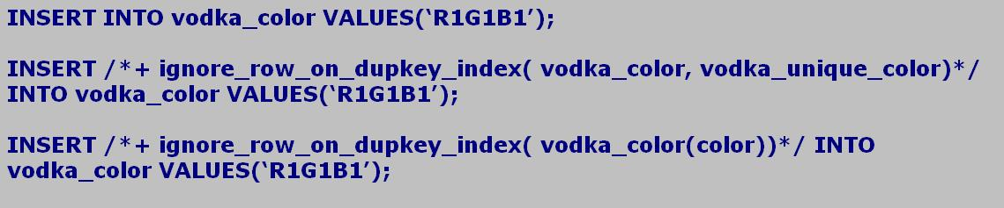
IGNORE_ROW_ON_DUPKEY_INDEX - Demo
http://sqlfiddle.com/#!4/04ef2/1
Notes:
Welcome to the Continuous Integration e-learning course.

Slide 46
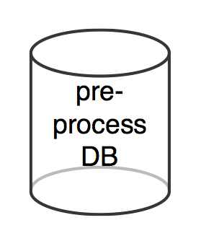
Preprocessor
To preprocess the input data before it is used by external table.
It can be system commands bat file, shell scripts or even a "c" program.

Slide 47
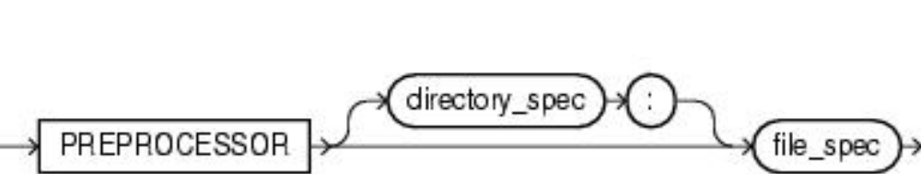
Preprocessor Syntax
The syntax of the PREPROCESSOR parameter is as follows
Directory spec – directory object containing the preprocessor program
File spec - specifies the name of the preprocessor program
Directory must have execute permission

Slide 48
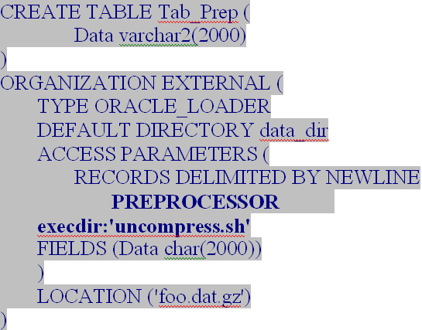
Preprocessor Example
Example to specify preprocessor

Slide 49
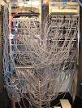
Unstructured Data Management
Notes:
Welcome to the Continuous Integration e-learning course.

Slide 50

What is Data?
Notes:
Welcome to the Continuous Integration e-learning course.

Slide 51
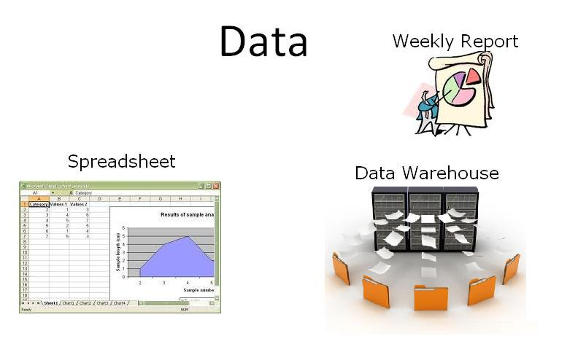
Data
Notes:
Welcome to the Continuous Integration e-learning course.

Slide 52
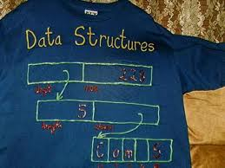
Data Structures
Notes:
Welcome to the Continuous Integration e-learning course.

Slide 53
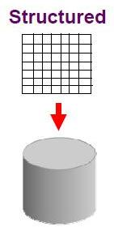
Structured Data
  Structured data refers to data that is identifiable because it is organized in a structure.
  The most common form of structured data or structured data records (SDR) is a database where specific information is stored based on a methodology of columns and rows.
  Structured data is also searchable by data type within content.
Notes:
Welcome to the Continuous Integration e-learning course.

Slide 54
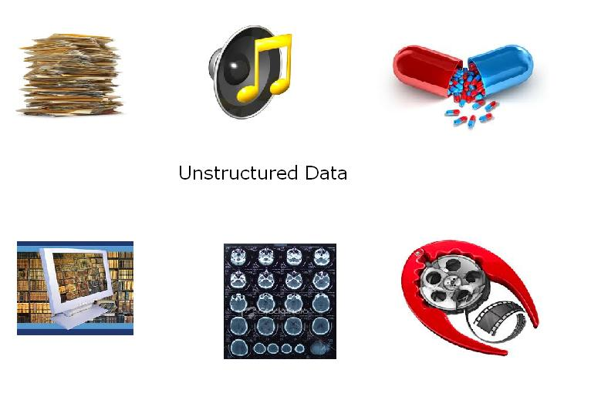
Unstructured Data
Notes:
Welcome to the Continuous Integration e-learning course.

Slide 55
Unstructured Data
Unstructured data refers to any data that has no identifiable structure.
This kind of data is not broken down into smaller logical structures and is not typically interpreted by the database or your application.
A photographic image stored as a binary file is an example of unstructured data.
Notes:
Welcome to the Continuous Integration e-learning course.

Slide 56
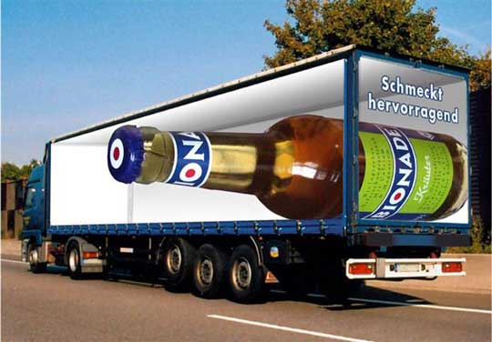
What is suitable for this unstructured Data?
Notes:
Welcome to the Continuous Integration e-learning course.

Slide 57
It’s Large object
Large Objects (LOBs) are a set of datatypes that are designed to hold large amounts of data.
Generic acronym LOB refer to the BLOB, CLOB, or DBCLOB data type.
Storing data in LOBs enables to access and manipulate the data efficiently in application.
A table can have multiple LOB columns. LOB columns in a table can be of any LOB type. tables are limited to a single LONG or LONG RAW column.
Notes:
Welcome to the Continuous Integration e-learning course.

Slide 58
Using LOB’s for Unstructured Data
Unstructured data cannot be decomposed into standard components
Example, data about an employee can be structured into a name, which is stored as a string; an identifier, such as an ID number, a salary and so on.
A photograph, on the other hand, consists of a long stream of 1s and 0s..
Also, unstructured data such as text, graphic images, still video clips, full motion video, and sound waveforms tends to be large in size
Notes:
Welcome to the Continuous Integration e-learning course.

Slide 59


Secure Files
Notes:
Welcome to the Continuous Integration e-learning course.

Slide 60
Why Secure Files?
The Secure Files functionality is a complete redesign of the implementation of large object (LOB) storage in Oracle 11g.
The original LOB storage, now known as BASICFILE, is still the default storage method,
SECUREFILE keyword enables the new storage method, which allows encryption for security and space savings using compression and deduplication.
Notes:
Welcome to the Continuous Integration e-learning course.

Slide 61
What is Secure Files?
Secure Files is a new 11g feature designed to break the performance barrier keeping file data out of databases
Next-generation LOBs - faster, and with more capabilities
Transparent deduplication, compression and encryption
Superset of LOB interfaces allows easy migration from LOBs
Notes:
Welcome to the Continuous Integration e-learning course.

Slide 62
Init params of Secure Files
The DB_SECUREFILE initialization parameter controls the default action of the database with regards to LOB storage.
Value | Description
ALWAYS | BasicFile storage options are ignored, and SecureFile default storage options are used for any unspecified options.
FORCE | All LOBs are created as SecureFile LOBs. BasicFile storage options are ignored, and SecureFile default storage options are used for any unspecified options.
PERMITTED | The default setting, which allows SecureFile LOB storage when the SECUREFILE keyword is used.
NEVER | Creation of SecureFile LOBs is not permitted.
IGNORE | Prevent creation of SecureFile LOBs, and ignore any errors associated with SecureFile storage options.
Notes:
Welcome to the Continuous Integration e-learning course.

Slide 63
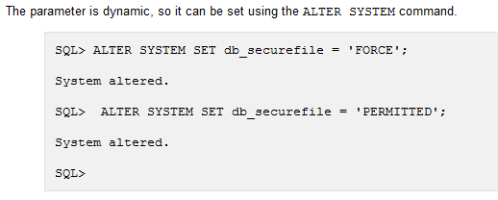
How to set Secure Files
Notes:
Welcome to the Continuous Integration e-learning course.

Slide 64
Secure Files Innovation
Write Gather Cache
  Subset of database buffer cache
  Gather data before writing into disk
  Greatly optimizes the I/O
Delta updates
  Provides special API to specify the object, list of delta, their lengths and offsets
Intelligent pre fetching
  LOB data and Locator fetched together in a single round trip
Notes:
Welcome to the Continuous Integration e-learning course.

Slide 65
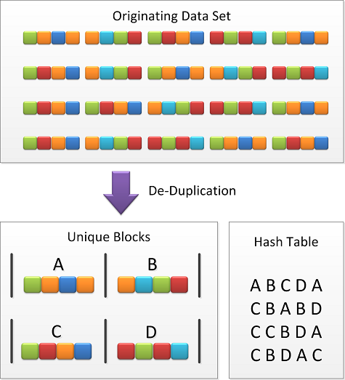
Secure Files Innovation - Deduplication
Single physical copy
Prefix hash & Full hash
Lookup index
Table or Partition level
Saves disk space and I/O
Notes:
Welcome to the Continuous Integration e-learning course.

Slide 66
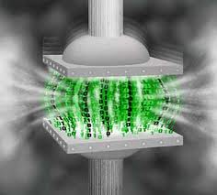
Secure Files Innovation - Compression
Advanced compression on all data types
Intelligent compression check
Random access of large files
Independent of Table or Index compression
Less Storage, reduced I/O, Less buffer cache
Notes:
Welcome to the Continuous Integration e-learning course.

Slide 67

Secure Files Innovation - Encryption
Encrypt Secure File object along with relational metadata
Old LOB can’t be encrypted
Block level
Industry standard encryption algorithms
Notes:
Welcome to the Continuous Integration e-learning course.

Slide 68

LOB history & Storage details

Slide 69
LOB history & Storage details
Type | Version | Features
LONG | 7 | To store unstructured data Storage 2GB Restricted to single column in a table All data is stored in tablespace
BLOB & CLOB | 8 | Stored either in-line or in a separate segment or tablespace Storage 4GB Created in multiple columns in a table Only the LOB locator is stored in the table column Stores LOBs that are less than approx 4000 bytes of data in the table column. All operations performed on these data types are under transaction control.
Notes:
Welcome to the Continuous Integration e-learning course.

Slide 70
LOB history & Storage details
Type | Version | Features
BFILE | 9 | Stored as operating system files outside the database Read-only access to data stored in storage devices like hard disks, network mounted files systems, CD-ROMs, Photo CDs, and DVDs. BFILE data is not under transaction control and is not stored by database backups.
Secure File | 11 | Stores data within the database Supports all types of content and all file sizes without compromising on the throughput and scalability aspects of performance. Supports ACID properties Each Secure file content is a collection of oracle database extents that are contiguous ranges of data blocks. Compression, Deduplication and Encryption. Bigger chunk size, Less Fragmentation, Prefetch and LOB-centric network protocol
Notes:
Welcome to the Continuous Integration e-learning course.

Slide 71

Migration of Existing LOBs
Notes:
Welcome to the Continuous Integration e-learning course.

Slide 72

Requirements
Version must be
11.1.0.0. or
higher
Tablespace must
be configured
as ASSM
(Auto Segment Space Management)
Notes:
Welcome to the Continuous Integration e-learning course.

Slide 73

Migration Methods
Online Redefinition
Alter table and
add partition
Create a partitioned table from non - partitioned table.
Highly recommended is Online redefintion
Notes:
Welcome to the Continuous Integration e-learning course.

Slide 74

Migration with Online Redefinition
Advantages:
System is up and available
during migration.
Advance features such as
compression, de-duplication,
encryption can be done as the
data is being migrated.
All features are available
immediately after migration.
Online redefinition requires free space equal to the original space.
Notes:
Welcome to the Continuous Integration e-learning course.

Slide 75
Online Redefinition ( Contd …)
Migrating an entire table
This feature works whether your table is partitioned or not.
    Create a new table with property Secure File.
    Migrate the data to the new table
    After completion, drop new table as it holds original table data.
Notes:
Welcome to the Continuous Integration e-learning course.

Slide 76

Online Redefinition - Demo
An example of Online Redefinition of a simple table with single LOB’s column.
Source table
Notes:
Welcome to the Continuous Integration e-learning course.

Slide 77
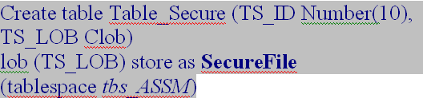
Online Redefinition - Demo
Destination table
tbs_ASSM is an ASSM tablespace.
Notes:
Welcome to the Continuous Integration e-learning course.

Slide 78

Online Redefinition - Demo
Migration steps
Performing actual redefinition is quite simple.
1. For our example, we will assume source and destination tables are already exist and user SCOTT.
2. Start the redefinition,
Notes:
Welcome to the Continuous Integration e-learning course.

Slide 79

Online Redefinition - Demo
3. Copy the table dependents,
4.Finish the redefinition (swaps the table names),
Notes:
Welcome to the Continuous Integration e-learning course.

Slide 80
Online Redefinition - Demo
5. Drop the destination table (optional),
When the above process completes, Table_Basic LOB column will become SecureFile LOB.
Notes:
Welcome to the Continuous Integration e-learning course.

Slide 81
Alter table and Add partition
Another method of migrating to Secure File is through use of Partition.
Assume, that our source table is a partitioned table.
Secure File can be enabled on new Partitions only.
Old data will continue to reside in the old format and can be migrated later.
Notes:
Welcome to the Continuous Integration e-learning course.

Slide 82
Migration of Non-Partitioned Table
The ALTER TABLE ... EXCHANGE PARTITION ... This syntax can be used to partition an existing table and exchange partition with another partition or table.
Assume that existing source table is not partitioned.
Create new table with partitions one with basic file and another secure file option.
Use Exchange partition option to exchange data between source table and new table.
Notes:
Welcome to the Continuous Integration e-learning course.

Slide 83

LOB’s in our environment
The following are the different LOBs used in our Environment.
BLOB
BFile
CLOB
Secure Files
Also, we have other case
Image storage system (ISS)
saves images in file systems and saves token in DB related to that file.
Notes:
Welcome to the Continuous Integration e-learning course.

Slide 84

Any Question?

Slide 85



